Slide 1
Topic 5
Space and Time Tradeoffs
Prof. Hanan Elazhary
Main source: A. Levitin, Introduction to the Design and Analysis of Algorithms, 3rd edition

Slide 2
Space-for-time Tradeoffs
Consider, as an example, the problem of computing values of a function at many points in its domain. If it is time that is at a premium, we can precompute the function’s values and store them in a table.
Two varieties of space-for-time algorithms
input enhancement — preprocess the input (or part of it) and store the additional information obtained (extra space) to accelerate solving the problem
counting sort
string matching (searching), e.g., Horspool
prestructuring — preprocess the input (extra space) to make accessing its elements faster and/or more flexible
hashing
indexing (e.g., B-trees)

Slide 3
String Matching (Searching)

Slide 4
String Matching
Several string matching (searching) algorithms are based on the idea of input enhancement for preprocessing an input pattern to get useful additional information for matching (searching) speed up
Knuth-Morris-Pratt (KMP) algorithm preprocesses an input pattern left to right
Boyer-Moore algorithm preprocesses an input pattern right to left and stores information into two tables
Horspool’s algorithm is a simplified version of Boyer-Moore algorithm, that uses one table only
O(m+n) time in the worst case
O(m+n) time in the worst case
Remember that brute force string matching was in O(mn) in the worst case

Slide 5
Horspool’s Algorithm
Align the pattern at beginning of the text and
starting with the rightmost character of the pattern and moving right to left, we compare the corresponding pairs of characters in the pattern and text
If a mismatch occurs, we determine how to shift the pattern to the right by checking the text character corresponding to the rightmost pattern character

Slide 6
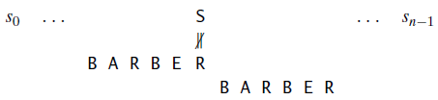
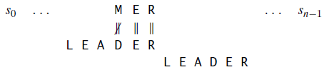
Horspool’s Algorithm, Contd.
Case 1: If the checked character does not match any pattern character, shift the pattern by its entire length
Case 2: If the checked character matches the rightmost pattern character, but not any other pattern character, shift the pattern by its entire length
Case1,2: We can shift the pattern by its entire length m as long as the checked character is not among the first m-1 characters of the pattern

Slide 7


Horspool’s Algorithm, Contd.
Case 3: If the checked character occurs in the pattern but not in the rightmost position, shift the pattern to align the rightmost occurrence with the checked character
Case 4: If the checked character matches the rightmost pattern character and some other pattern characters, shift the pattern to align the next rightmost occurrence in the pattern with the checked character
Case 3,4: Otherwise, we can shift the pattern by the distance from the rightmost occurrence of the checked character among the first m-1 characters of the pattern and the rightmost pattern character
Notes:
We don’t care about matching the third R, for example in REORDER until the 2nd is correctly matched

Slide 8
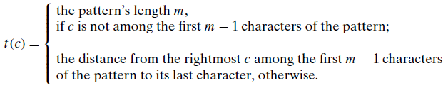
Horspool’s Algorithm, Contd.
Noticing that the shift depends on the match between the checked character and the pattern characters,
we use the idea of input enhancement to speed up the process of determining how much to shift the pattern when a mismatch occurs
Create a shift table indexed by all possible text (and pattern) characters
Preprocess the pattern to compute for each shift table entry the pattern shift size (when a mismatch occurs) using the formula
Case 1 & 2
Case 3 & 4
Notes:
For example, for the pattern BARBER, all the table’s entries will be equal to 6, except for the entries for E, B, R, and A, which will be 1, 2, 3, and 4, respectively.

Slide 9
Horspool’s Algorithm, Contd.
Horspool’s algorithm
Create a shift table indexed by all possible text (and pattern) characters
Preprocess the pattern to compute for each shift table entry the pattern shift size (when a mismatch occurs)
Align the pattern at beginning of the text
Starting with the rightmost character of the pattern and moving right to left, compare the corresponding pairs of characters in the pattern and text until either all pattern characters are matched then stop or a mismatch occurs
When a mismatch occurs, shift the pattern to the right along the text according to the shift table’s entry for the text’s character c aligned with the last character in the pattern
Repeat until either a matching substring is found, or the pattern reaches beyond the last character of the text

Slide 10
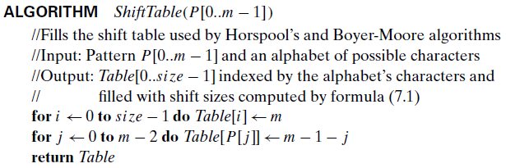
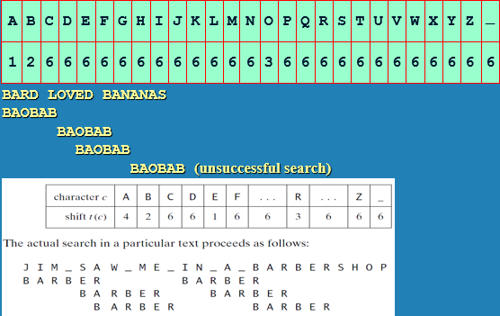
Horspool’s Algorithm, Contd.
The default shift size is the pattern size m
distance between last pattern character (m-1)and one of its first m-1 characters
For each of the first m-1 characters of the pattern, modify the corresponding table entry

Slide 11
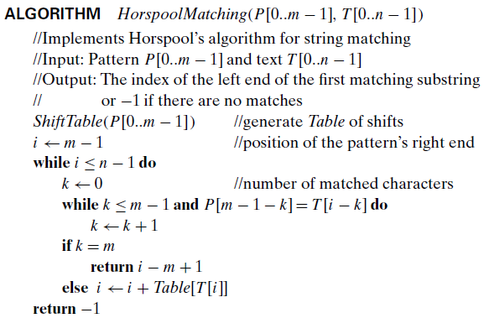
Horspool’s Algorithm, Contd.
the rightmost pattern character position
While the rightmost pattern character position does not reach beyond the text
While the number of matched characters is smaller than the pattern length and there is a match
Increment k with each match and use it to move right to left along the pattern and text
If all pattern characters are (matched)
return the leftmost position of the pattern
Otherwise, (mismatch), Shift the rightmost pattern character position by the table entry indexed by the text character at this position
When the rightmost pattern character position reaches beyond the text, no matching

Slide 12
Example 1
Example 1
The entire length of the pattern BAOBAB is 6, so the shift size is 6 for all characters that are not among the first m-1 characters of the pattern
The shift size for the other characters is the distance from the rightmost occurrence of the character among the first m-1 characters of the pattern and the rightmost pattern character
A: 1
B: 2
O: 3
12

Slide 13
Example 2
Example
The entire length of the pattern BARBER is 6, so the shift size is 6 for all characters that are not among the first m-1 characters of the pattern
4 1 6 2 3
The shift size for the other characters is the distance from the rightmost occurrence of the character among the first m-1 characters of the pattern and the rightmost pattern character
E: 1
B: 2
R: 3
A: 4
13

Slide 14
Hashing

Slide 15
Dictionary
A dictionary is a data structure which stores key-value (or key-element) pairs and supports the operations
search (lookup)
insert
delete
When a key is passed to a dictionary, it returns the corresponding element
e.g., given a phone number, return the caller’s name

Slide 16
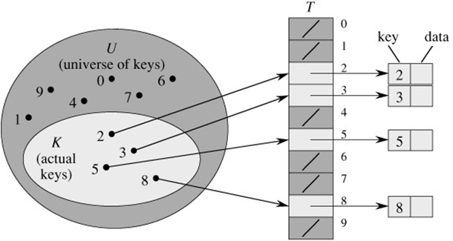
Dictionary, Contd.
Implementations
Use a linked list
Use a balanced binary search tree
Use a Direct Access Table (DAT)
Key becomes address of the element
Extremely Efficient
Impractical when the number of possible keys is large (extremely large size), or when it far exceeds the number of actually stored keys
https://cis300.cs.ksu.edu/dictionaries/linked-list-impl/; http://see-programming.blogspot.com/2013/05/implement-dictionary-using-binary.html; https://web.stanford.edu/class/archive/cs/cs161/cs161.1168/lecture9.pdf

Slide 17
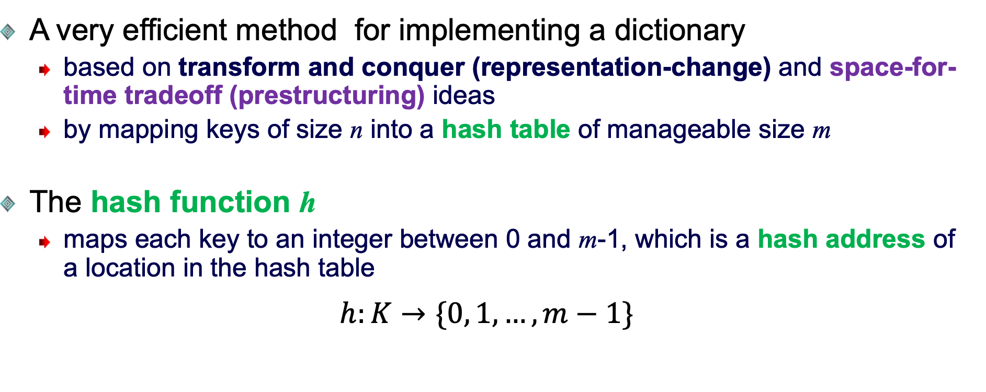
Hashing
A very efficient method for implementing a dictionary
based on transform and conquer (representation-change) and space-for-time tradeoff (prestructuring) ideas
by mapping keys of size n into a hash table of manageable size m
The hash function h
maps each key to an integer between 0 and m-1, which is a hash address of a location in the hash table
$$h:K→\{0, 1, …, m−1\}$$

Slide 18
Hashing, Contd.
Generally, a hash function should
be easy to compute
distribute keys about evenly throughout the hash table
Some hash functions
mod
truncation, e.g., keep 3 right most digits
squaring, e.g., square and truncate
radix conversion, e.g., 1234 treat it to be base 11, truncate if necessary
folding, e.g., 123|456|789: add them and take mod of table size
Important applications
symbol tables
databases (extendible hashing)
https://www.geeksforgeeks.org/folding-method-in-hashing/; http://estudies4you.blogspot.com/2017/09/symbol-table-organizing-using-hashing.html; https://www.geeksforgeeks.org/extendible-hashing-dynamic-approach-to-dbms/
Notes:
radix conversion: 1234 in base 11 converts to 1610 in base 10:
1234₁₁​=1×113+2×112+3×111+4×110=1610₁₀

Slide 19
Hashing, Contd.
Hash Function = mod(key, 10)
DAT versus hashing
Direct Access Table
Hash Table
Address Record
Address Record
…
5336663 | “Sara”
…
…
5661116 | “ Ross”
…
0
1
2
3
4
5
6
7
8
9
5336663 | “Sara”
5661116 | “ Ross”
Non-numeric keys can be converted to numeric values, for example by adding the ASCII values of all characters of the key

Slide 20
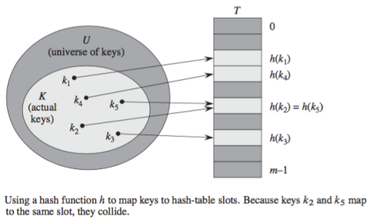
Hashing, Contd.
Collisions problem
If h(K1) = h(K2), there is a collision
Good hash functions result in fewer collisions, but some collisions should be expected
Two principal hashing schemes handle collisions differently
Open hashing
Closed hashing
20

Slide 21
Hashing, Contd.
Open hashing
each cell is a header of linked list of all keys hashed to it
Closed hashing
one key per cell
in case of collision, finds another cell by a technique such as
linear probing: use next free cell (bucket)
quadratic probing: use next free cell (bucket) distant by 1, 4, 9, 16, … positions
double hashing: use second hash function to compute increment

Slide 22
Open Hashing (Separate Chaining)
Keys are stored in linked lists outside a hash table whose elements serve as the lists’ headers
Example
A, FOOL, AND, HIS, MONEY, ARE, SOON, PARTED
h(K) = sum of K’s letters’ positions in the alphabet MOD 13
e.g.,
h(FOOL)
= (6+15+15+12)
MOD13 = 9
e.g., search for KID
h(KID)
= (11+9+4)
MOD13 = 11
Key | A | FOOL | AND | HIS | MONEY | ARE | SOON | PARTED
h(K) | 1 | 9 | 6 | 10 | 7 | 11 | 11 | 12
0
1
2
3
4
5
6
7
8
9
10
11
12
A
AND
MONEY
FOOL
HIS
ARE
PARTED
SOON

Slide 23
Open Hashing (Separate Chaining), Contd.
Keys: 0, 1, 4, 9, 16, 25, 36, 49, 64, 81
hash(key) = key % 10
0
0
1
81
1
2
3
4
64
4
5
25
6
36
16
7
8
9
49
9

Slide 24

Open Hashing (Separate Chaining), Contd.
If hash function evenly distributes n keys among m cells (buckets) of the hash table
average length of linked list (load factor) will be α = n/m and is very important for the efficiency of hashing (typically kept small, ideally about 1)
the average number of pointers inspected (probes) in successful searches S, and unsuccessful searches, U, turns out to be
Advantage
reduction in average linked list size by a factor of m
still works if n > m
Disadvantage
requires the implementation of a second data structure (a linked list using pointers)
Notes:
For example, if the load factor α is 4, it means there are on average 4 elements per cell (bucket).
In an unsuccessful search, you would expect to inspect all 4 elements, so: U≈α=4
In a successful search, you would expect to traverse about half of these elements (on average), so: S≈1+4/2=1+2=3
Therefore, in a successful search, you expect to traverse about 3 pointers in total:
1 pointer (probes) to find the bucket (cell)
2 pointers ( probes) within the bucket (link list).

Slide 25
Closed Hashing (Open Addressing)
Keys are stored inside a hash table, one key per cell
and in case of collision, finds another cell by a technique such as
linear probing,
quadratic probing, or
double hashing
Linear probing
use next free cell even if you wrap around

Slide 26
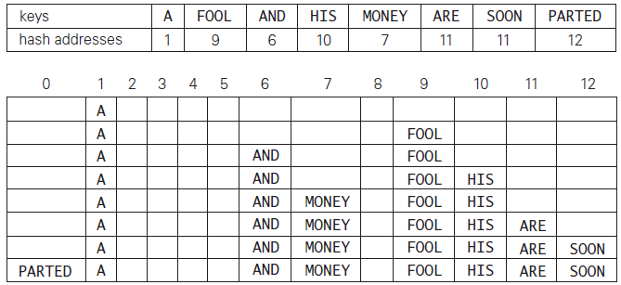
Closed Hashing (Open Addressing), Contd.
Example
Insert items with keys into an empty hash table using linear probing
using h(K) = sum of K’s letters’ positions in the alphabet MOD 13
Try
h(SOON)
h(SOON)+1
h(PARTED)
h(PARTED)+1
→ wrap around
After insert A
After insert FOOL
After insert AND
After insert HIS
After insert MONEY
After insert ARE
After insert SOON
After insert PARTED

Slide 27
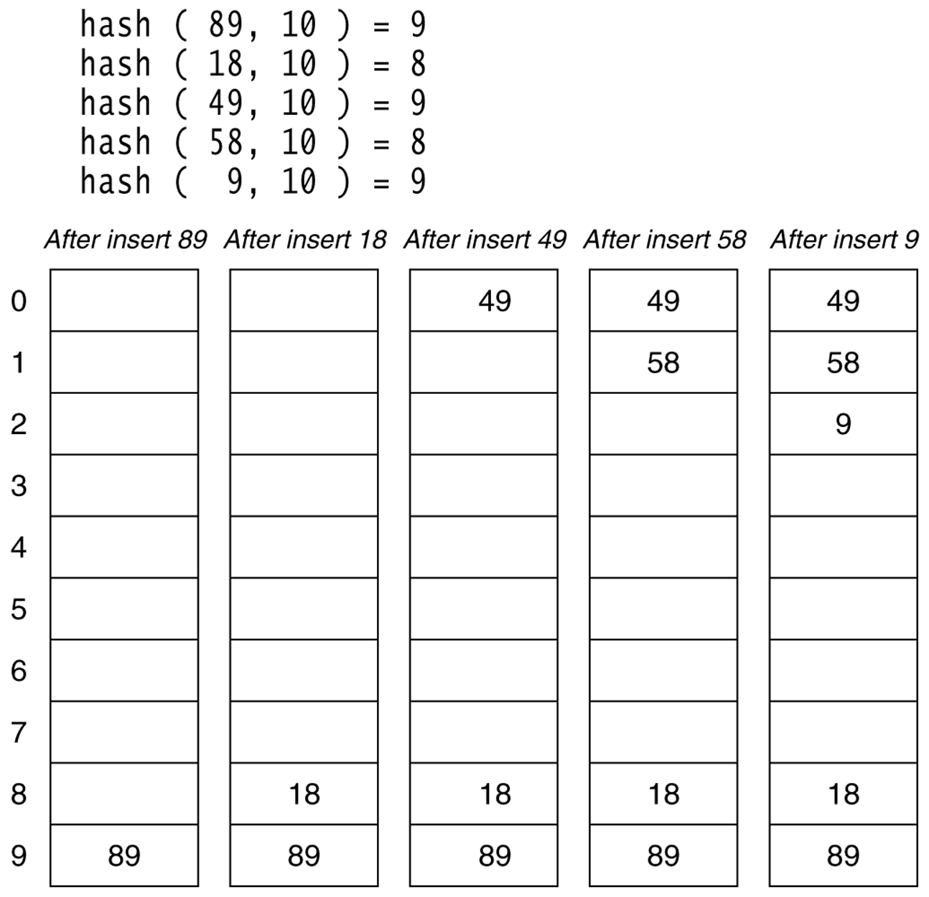
Closed Hashing (Open Addressing), Contd.
Example
Insert items with keys 89, 18, 49, 58, 9 into an empty hash table using linear probing
using h(K) =K % 10

Slide 28

Closed Hashing (Open Addressing), Contd.
Advantage
avoids pointers
Disadvantages
does not work if n > m
deletions are not straightforward (if we delete the key ARE from the last cell of the hash table, we will be unable to find the key SOON afterward)
the average number of times the algorithm must access the hash table (probes to find/insert/delete a key) in successful and unsuccessful searches depends on the load factor α=n/m (hash table density) and collision resolution strategy
For linear probing

Slide 29
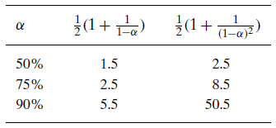
Closed Hashing (Open Addressing), Contd.
As the hash table gets closer to being full (α approaches 1), number of probes in linear probing increases dramatically
Notes:
A load factor of 50% or =0.5 means that only half of the available
A load factor of 75% or =075 means that 75% of the available slots in the hash table are occupied. For example, if the hash table has 20 slots, then 15 slots are currently used, and 5 slots are empty.

Slide 30
Questions?

